Slide 1
Swine Disease Classification Using Deep Learning
DATA 298B
Dr. Jerry Zeyu Gao
Team 7:
Hruthik Vinnakota
Jugal Kishore Ruvva
Rajeev Yenugula
Ramya Sudireddy

Slide 2
AGENDA
PROJECT INTRODUCTION 3
DATA ENGINEERING 9
MACHINE LEARNING MODELS AND COMPARISON 5
WEB SYSTEM DESIGN AND DEVELOPMENT 6
SYSTEM DESIGN AND IMPLEMENTATION 11

Slide 3
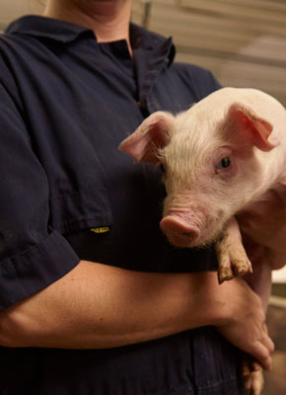
Project Introduction
Introduction
Background
Technology Survey
Literature Survey
Road Map

Slide 4
Introduction
Swine Respiratory Diseases:
Significant agricultural sector challenges impact animal welfare and industry economics.
Accurate and timely disease identification is crucial for effective disease management.
Deep Learning Application:
Showcases promising applications in veterinary science.
Its ability to process complex data, such as audio signals, enables advanced analysis and classification.
Project Objective:
To employ and develop a robust deep learning methodology to classify accurately.
It is to develop a user interface for efficient and easy disease identification.
Challenges in Swine Disease Diagnosis:
Traditional diagnostic methods often need more speed, accuracy, and scalability.
Significance and Impact:
Can revolutionize disease monitoring, prevention, and treatment strategies.
Holds tremendous potential for enhancing livestock health and agricultural productivity.

Slide 5
Background
Prevalence of Swine Respiratory Diseases:
Respiratory diseases are a leading cause of morbidity and mortality in swine, affecting up to 35% of pigs in some herds (Source: National Pork Board Report, 2021).
Impact on the Swine Industry:
Estimated annual losses of over $600 million due to respiratory diseases, impacting production efficiency and economic sustainability (Source: USDA Economic Research Service, 2020).
Challenges in Disease Diagnosis:
Conventional diagnostic methods, such as visual inspection and serological testing, often have limited accuracy rates ranging from 60% to 80% (Source: Journal of Veterinary Diagnostic Investigation, 2019).
Advancements in Deep Learning:
Convolutional neural networks (CNNs) have shown significant promise in accurately identifying and classifying animal sounds, with accuracy rates exceeding 80% (Source: Journal of Animal Science, 2022).
Need for Advanced Diagnostic Solutions:
A survey revealed that over 80% of swine veterinarians expressed a critical need for more advanced and efficient diagnostic tools to combat respiratory diseases in swine (Source: American Association of Swine Veterinarians Survey, 2021).

Slide 6
Technology Survey
Title | Country | Method Employed | Data Source | Key Findings | Accuracy
Fusion of Acoustics and Deep Features for Pig Cough sound Recognition | China | Support Vector Mechanism | Microphones and soundcards | Combining acoustics and deep features improves accuracy. Required substantial amount of labeled data | 97.35%
Automatic Detection and Recognition of Pig Wasting Diseases using Sound Data in Audio Surveillance System | South-Korea | Sparse Representation Classifier | Wireless Sensor Network, Camcorder | Eliminating the need for frequent system updates. It stands out for its cost effectiveness | 94.0%
Investigation of acoustic and visual features for pig cough classification. | China | SVM, KNN, Random Forest | Crowdsourcing from pig house in Harbin, Heilongjiang Province, China | Combined both visual and acoustic features and created a new feature vector by dimension reduction | 96.45%
Cough sound analysis to identify respiratory infection in pigs | Italy | FET, RMS | Crowd sourcing from lab and field | Used available data to synthesis new data and verified the accuracy. | 94.5%
Real-time Recognition of Sick Pig Cough Sounds | China | Fuzzy C-means Cluster | Crowdsourcing and induced coughs in a laboratory | Pig cough sounds and false sounds are classified using the power signal density method. It is useful in cases where immediate action is required | 85.5%
Research on Improved Dense Nets Pig Cough Sound Recognition Model Based on SENets | China | Dense Nets + SE-DenseNet-121 | Artificial pig sound generation using signal acquisition system | Improved the performance of Dense Net model using SENets by 0.9% with overall accuracy | 93.8%

Slide 7
Literature survey – AI and ML Usage
Paper | Model | Key Points
Recognition System for Pig Cough based on Probabilistic Neural Networks | PNN | The research utilizes novel neural network methods based on probabilistic neural networks for pig cough recognition
Automatic Monitoring and Detecting of Tail-Biting Behavior in Groups of Pigs Using Video-Based Deep Learning Methods | CNN-LSTM | The CNN-LSTM model explains the better performance in recognizing the tail-biting behavior compared to CNN-CNN models
Automatic Detection and recognition of Pig Wasting Diseases using Sound Data in Audio surveillance Systems | Mel Frequency cepstral coefficients (MFCC) | The technology offers an efficient and economical solution for detecting pig wasting diseases using cough sounds
An Improved Machine Learning Model for Pig Abnormal Voice Recognition | Hidden Markov Model (HMM) | This technology enhances sound recognition efficiency by introducing sound noise reduction and machine learning algorithms
Animal Vocal Recognition-Based Breeding tracking and Disease Warning | MFCC, LSTM, ResNet | MFCC parameters are extracted from the original frequency and advanced preprocessing techniques achieves a better accuracy with LSTM and ResNet
Alarm Call Analysis of Farm Pigs Using Deep Learning and Noise Filtering Methods. | EfficientNet-Bo, ResNet-18 | The study utilizes pre trained models, data augmentation and noise filtering to analyze farm pig alarm calls effectively.

Slide 8
Project Life Cycle
Data Collection
Data Collection
Deploy Models
Data Pre-Processing
Data Pre - Processing
ROAD MAP
Data Preparation
Model Development
Models Evaluation
Data Preparation
Model Evaluation
Model Development
Deploy Models

Slide 9
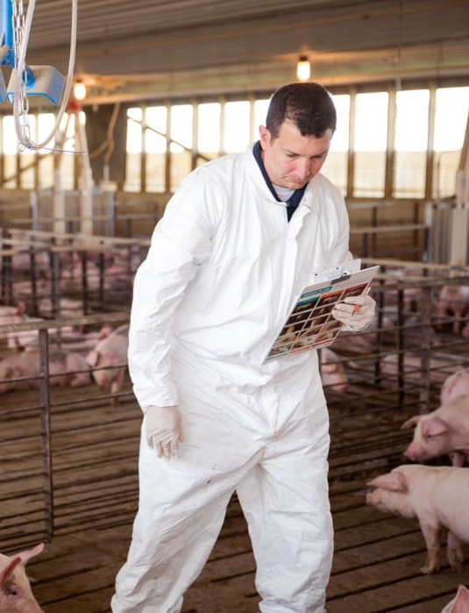
Data Engineering
Data Flow
Data Requirements
Data Collection
Data Pre-Processing
Feature Extraction
Data Preparation
Data Analytics

Slide 10




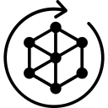
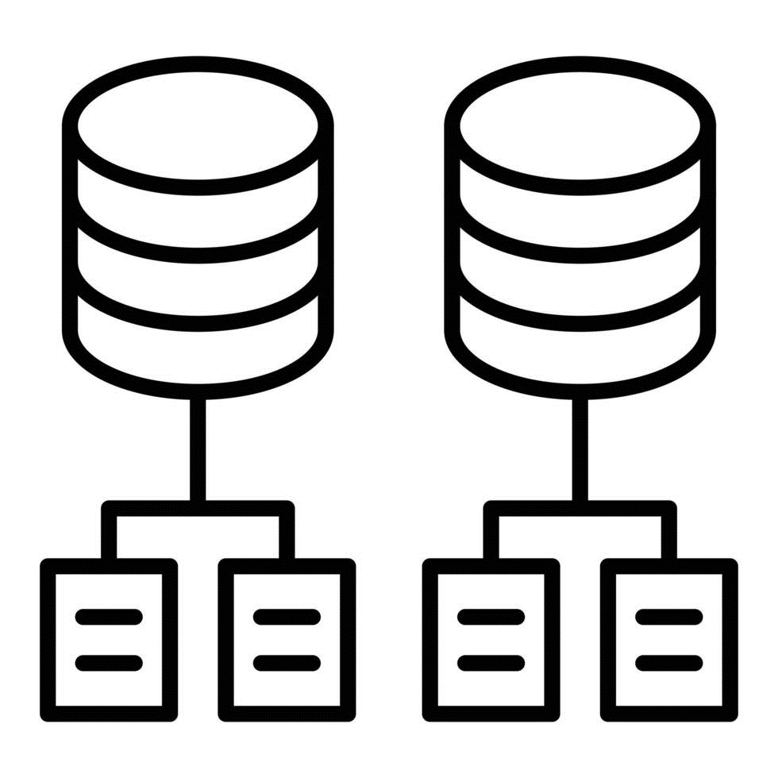


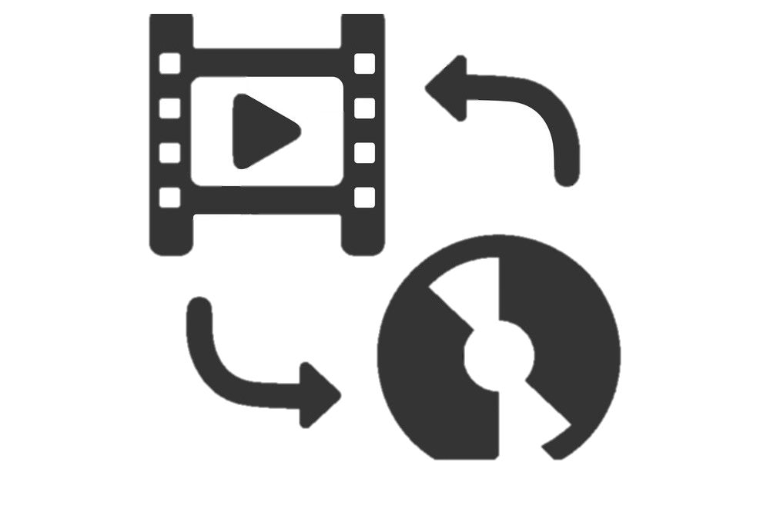

Data Flow
Data Splitting
Different data types
Data are prepared for modeling
Data Preparation
Feature Extraction
Data Preprocessing
Data
Collection

Slide 11
Data Requirements
Task | Data Characteristics
Cough sound analysis | Audio recordings of swine coughs
Detection of swine behavior anomalies | Audio recordings of swine normal behavior
Classification of swine coughs | Labeled dataset of cough audio recordings
Skin disease classification | High-resolution skin images
Identification of common symptoms through image analysis | Diverse dataset of skin lesions associated with swine diseases

Slide 12
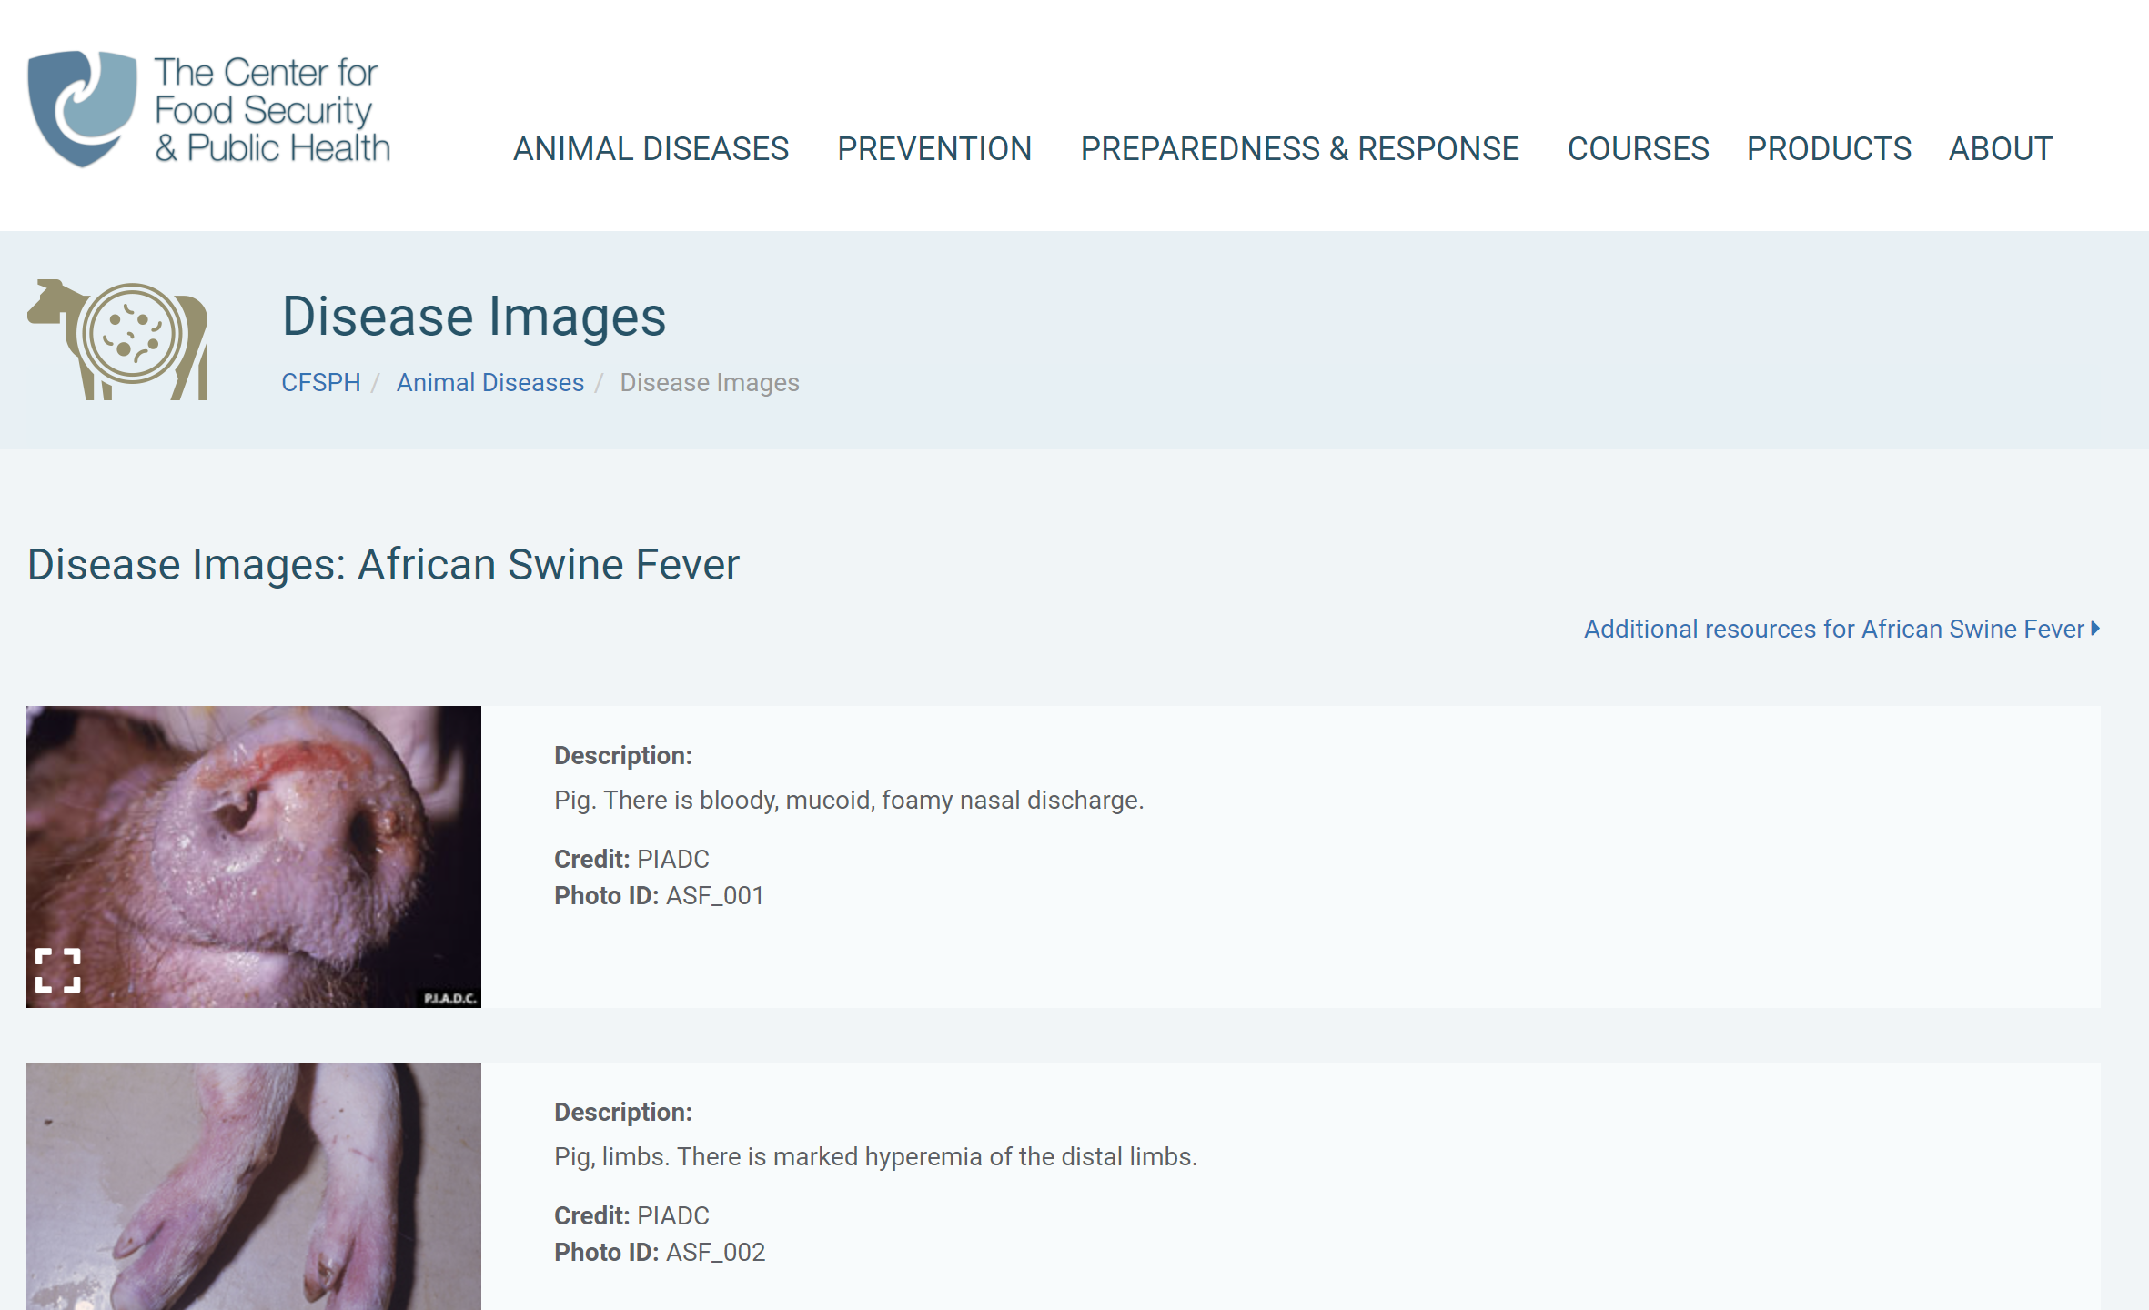
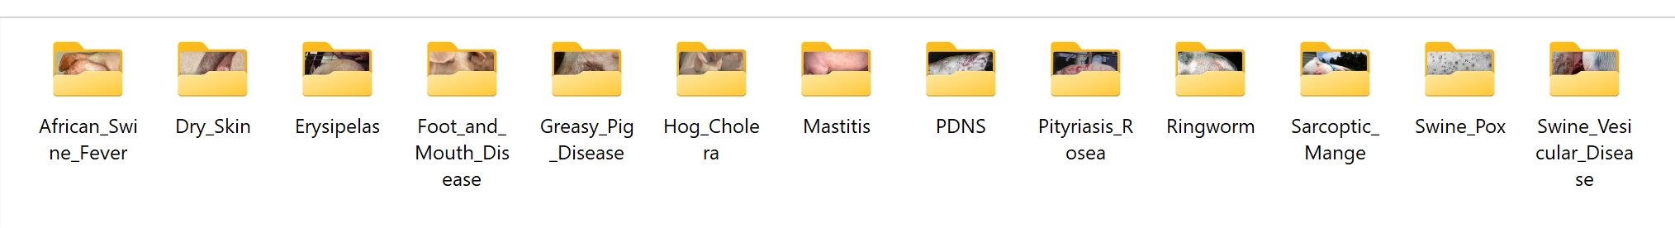
Data Collection : Image
Learn about most common skin diseases in swine.
Download swine skin images from different sources:
Iowa State University Veterinary Department
The Center for Food Security and Public Health
Cornell Veterinary Medicine
Google Search
Download .jpeg files for a total of 13 different skin diseases.

Slide 13
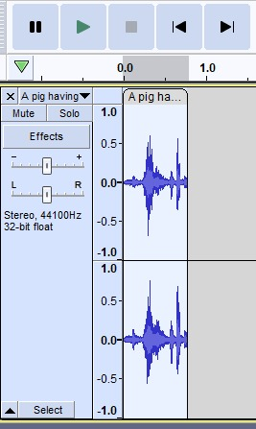
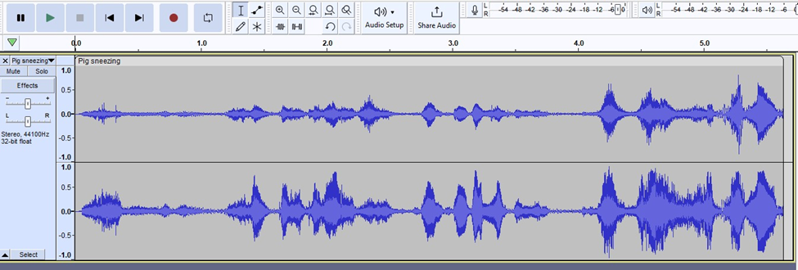
Data Collection : Audio
Selected audio and videos based on video caption and description.
Audio extracted from video using Y2mate.
Segmented cough sounds using Audacity.
Totally cough sounds extracted for 3 different disease.
Project involves amalgamation of data samples for
Pneumonia
Porcine Reproductive and Respiratory Syndrome (PRRS)
African Swine Fever in swine

Slide 14
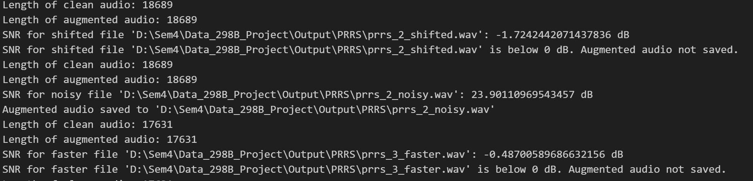
Data Pre-Processing : Audio
Applied augmentation techniques to the original dataset.
Evaluated the quality of the generated pig cough sounds
Objective evaluation involve metric Signal-to-Noise Ratio (≥10 DB)
Subjective evaluation involves listening to the sounds and assessing their similarity to real pig coughs.
Data Augmentation and Synthesis techniques includes:
Pitch Shifting
Stretching
Accelerating
Adding Noise

Slide 15
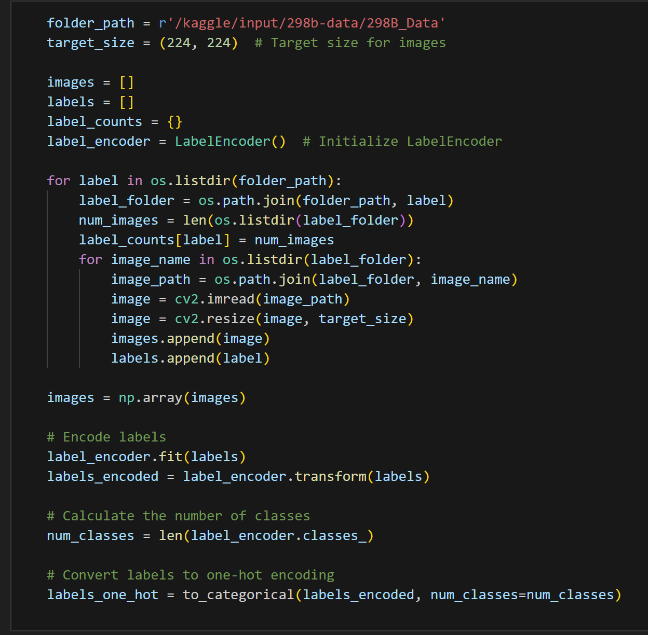
Data Pre-Processing : Image
Read the image from path and label as per the folder name.
Resize the image to (224, 224).
Decode the image from JPEG format to tensor format to obtain the pixel values, color channels.
Image augmentation – Random flip, rotation, and contrast.
Preprocess the image specific to the mode, which typically involves normalization and transformation to the format expected by the model.
Image reading and pre-processing

Slide 16





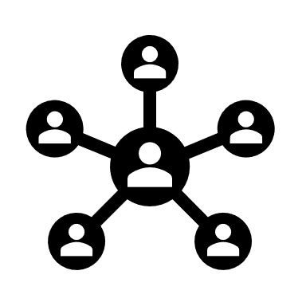





Data Preparation – Data Flow
Input Data
Data Preprocessing
Users
Audio Disease Classification
Swine disease detected
Image Disease Classification
Data Preparation

Slide 17
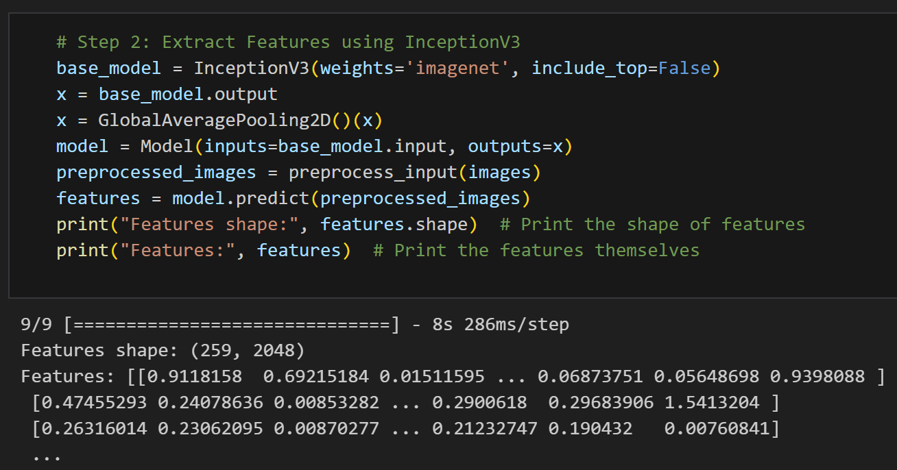
Feature Extraction
Feature extraction for Audio data using MFCC:
Extracting MFCCs involves several steps: Pre-emphasis, Frame Blocking, Fast Fourier Transform (FFT), Mel Filtering, Log Filter.
The resulting coefficients represent the compact features capturing the essential audio characteristics, which serve as valuable features.
Feature extraction for Image data:
A pre-trained CNN (Inception V3) is used to extract the features from the preprocessed images.

Slide 18
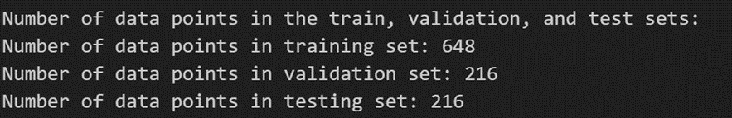
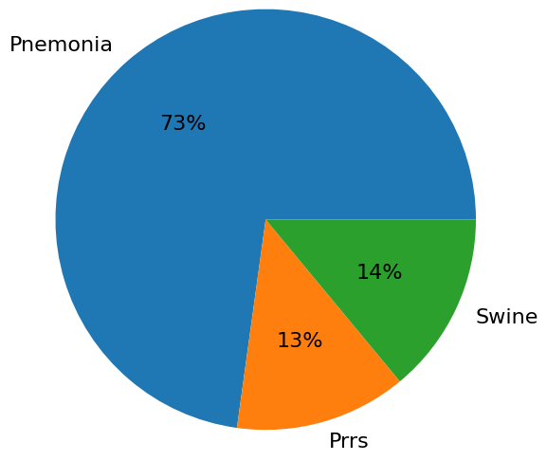
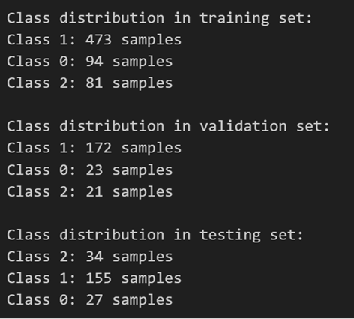
Data Preparation: Audio
The dataset is split into 60:20:20 ratio for training, validation and testing.
The number of data points in train, validation and test sets :
The class distribution after the split is as follows:

Slide 19
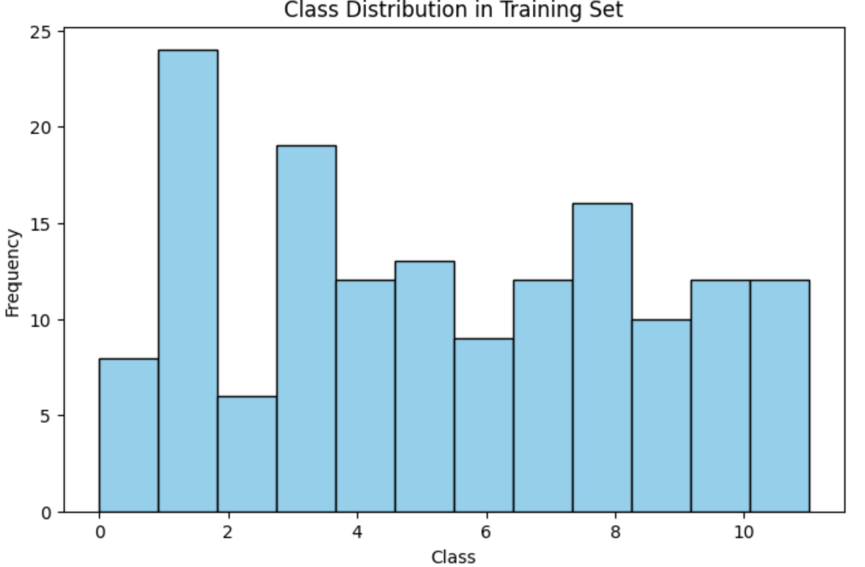
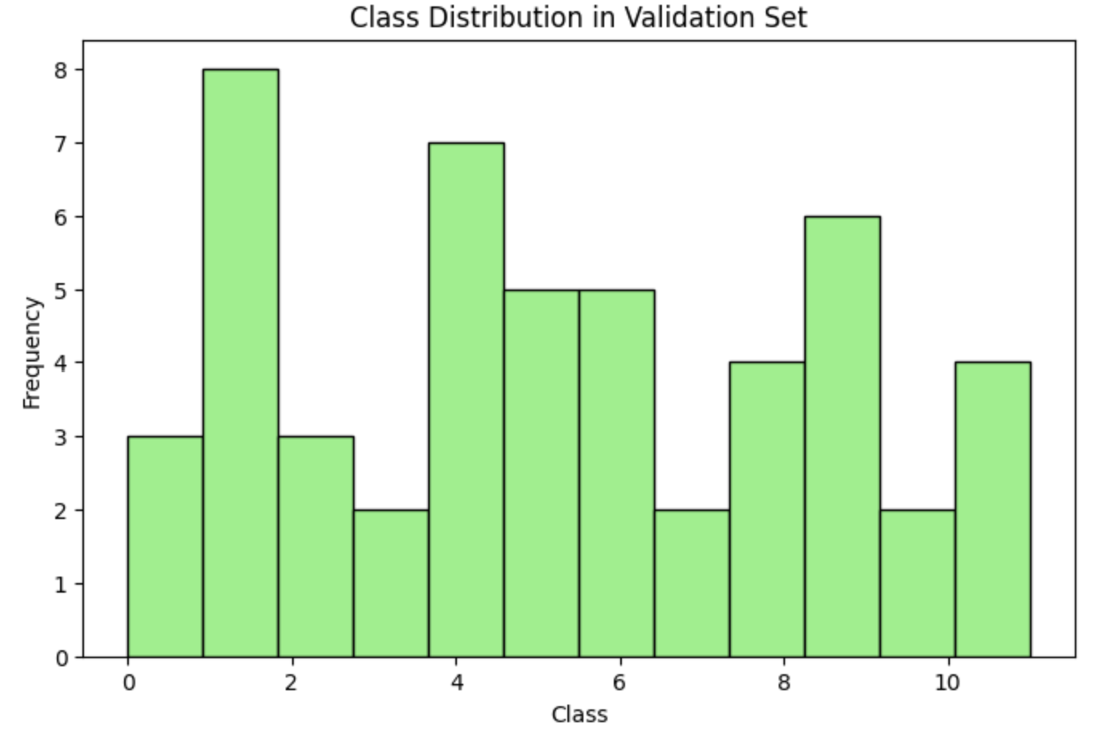
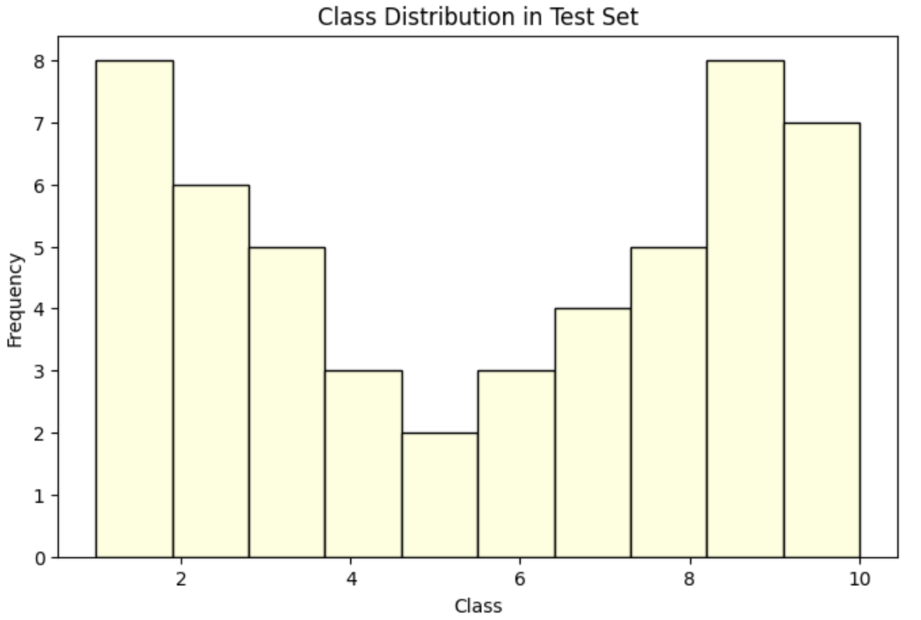
Data Preparation: Image
The dataset is split into 60:20:20 ratio for training, validation and testing.
The class distribution after the split is as follows:

Slide 20
Data Analytics Results
Big data Statistics
Stage | Dataset | Statistics
Pre-Processing | Pneumonia | 800 samples, 100 MB
 | PRRS | 136 samples, 8.21 MB
 | African Swine Fever | 144 samples, 11 MB
End of pre-processing | Processed audio dataset | 1080 samples, 119 MB
Data Transformation | Class label dataset | 976 rows x 2 columns
 | MFCC feature dataset | 1080 rows x 2 columns
 | Padded dataset | 1080 rows x 3980 columns
Data preparation | Training set | 648 rows x 3980 columns
 | Testing set | 216 rows x 3980 columns
 | Validation set | 216 rows x 3980 columns
Dataset | Statistics
Skin Disease | 259 samples, 1.5 MB
Processed image dataset | 259 samples, 1.5 MB
Feature dataset | 259 rows x 2028 columns
Training set | 155 rows x 2028 columns
Testing set | 52 rows x 2028 columns
Validation set | 52 rows x 2028 columns

Slide 21
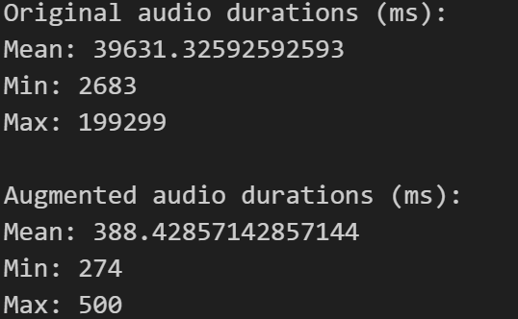
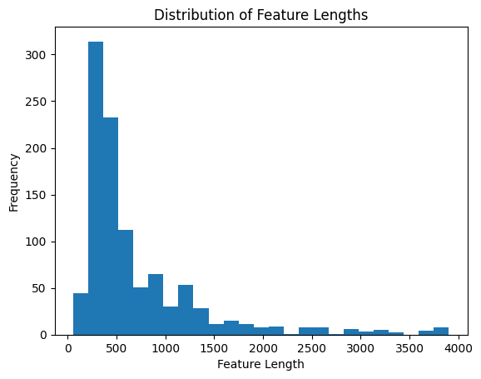
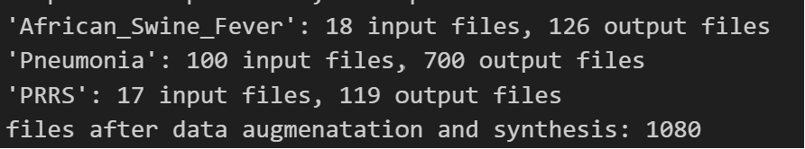
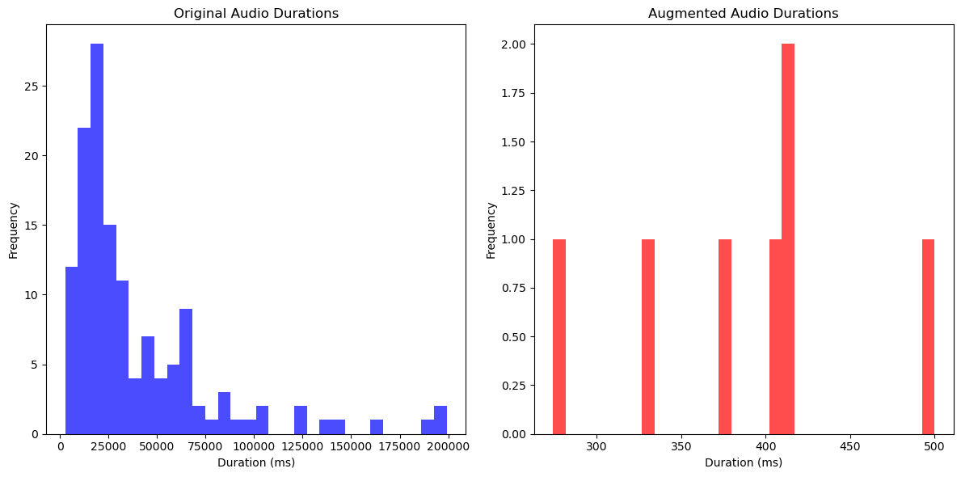
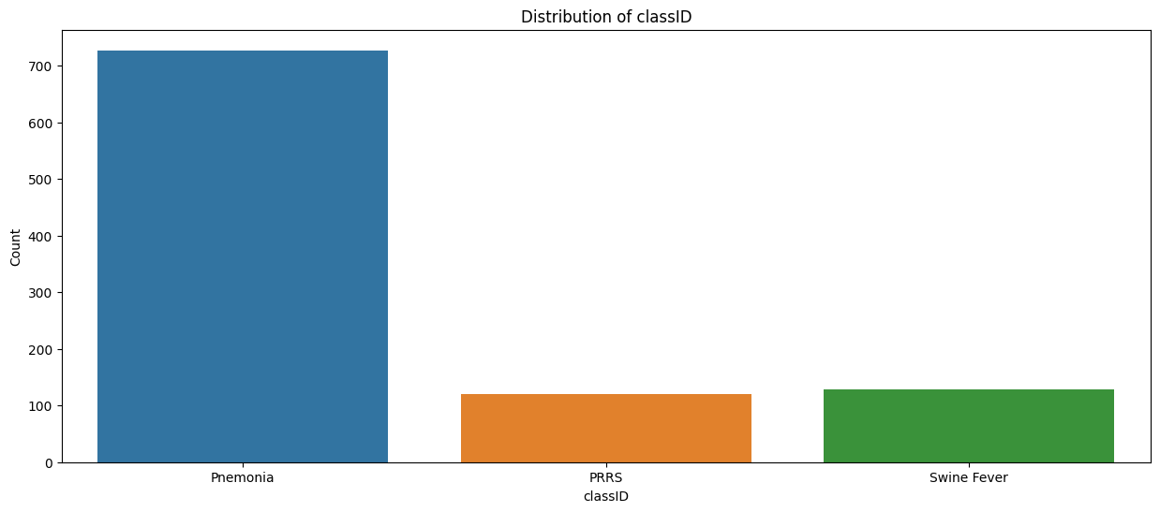
Data Analytics Results: Audio

Slide 22
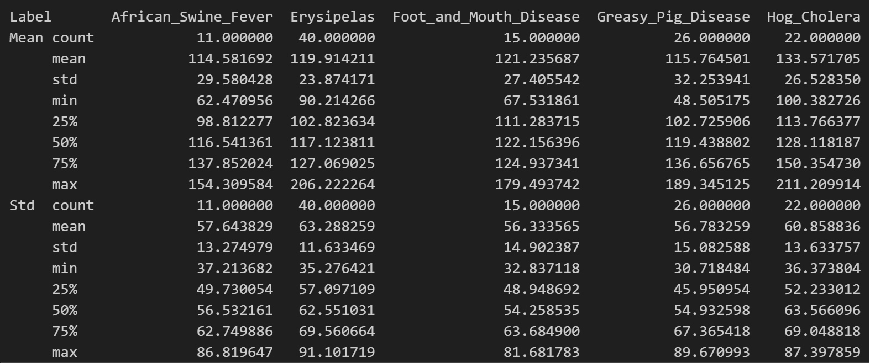
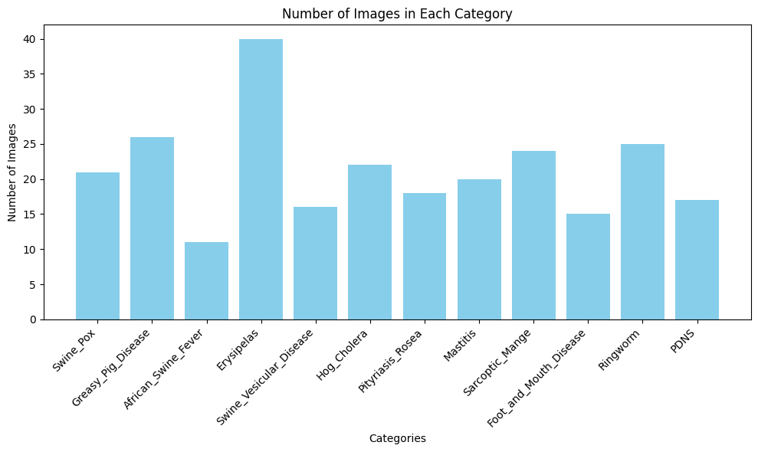
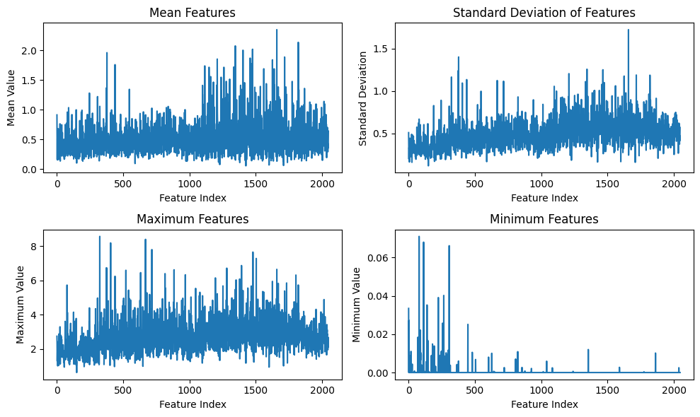
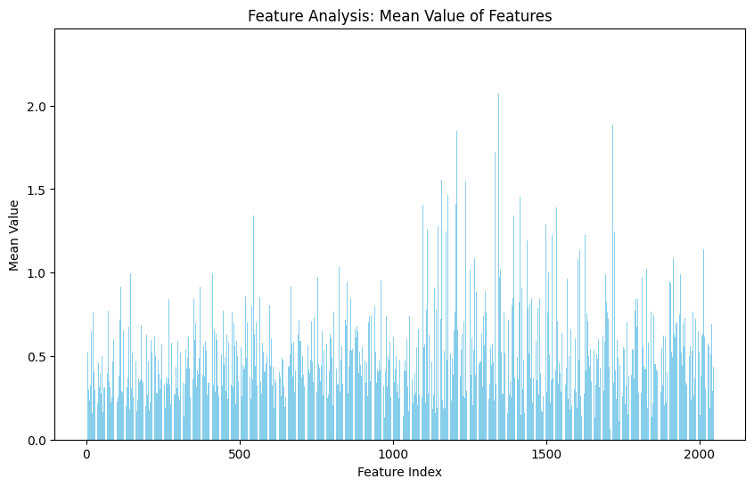
Data Analytics Results: Image

Slide 23
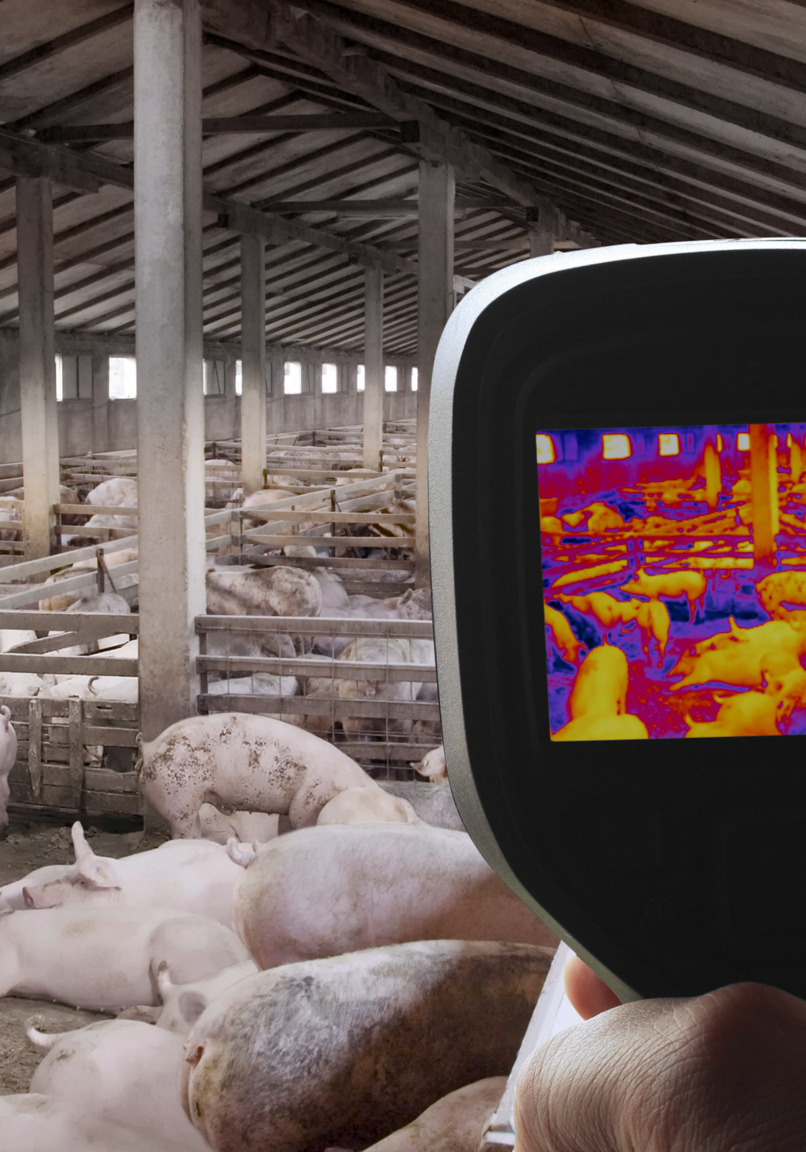
Machine Learning Models and Comparison
DenseNet
ResNet
Recurrent Neural Network
LSTM
MobileNet
Model Comparison

Slide 24
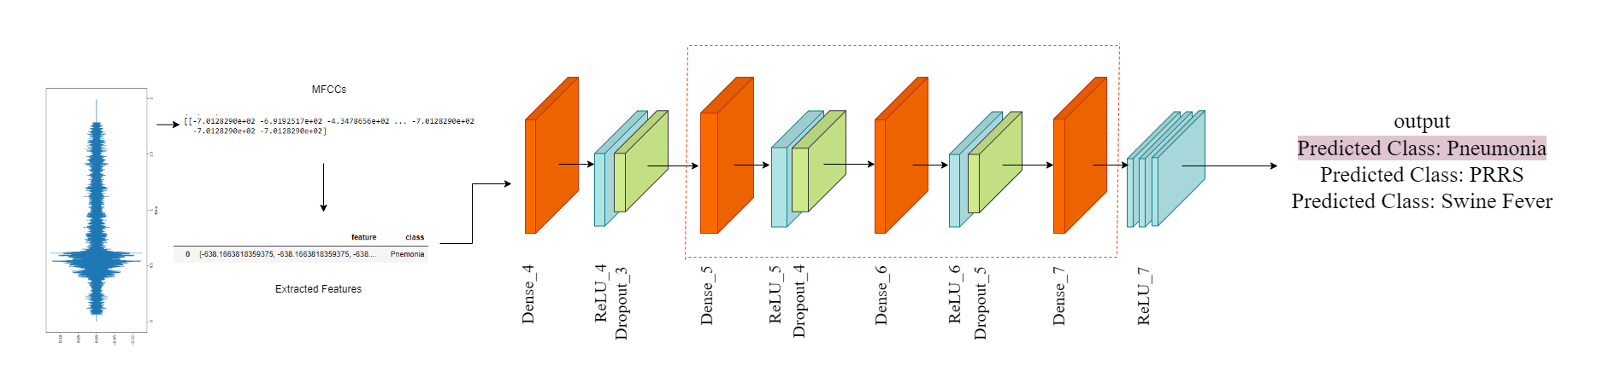
Proposed Models
DenseNet
Dense Convolutional Network (DenseNet):
A densely connected CNN architecture where each layer is connected to every other layer in a feed-forward fashion.
This connectivity pattern enhances feature propagation resulting in solid feature learning.

Slide 25
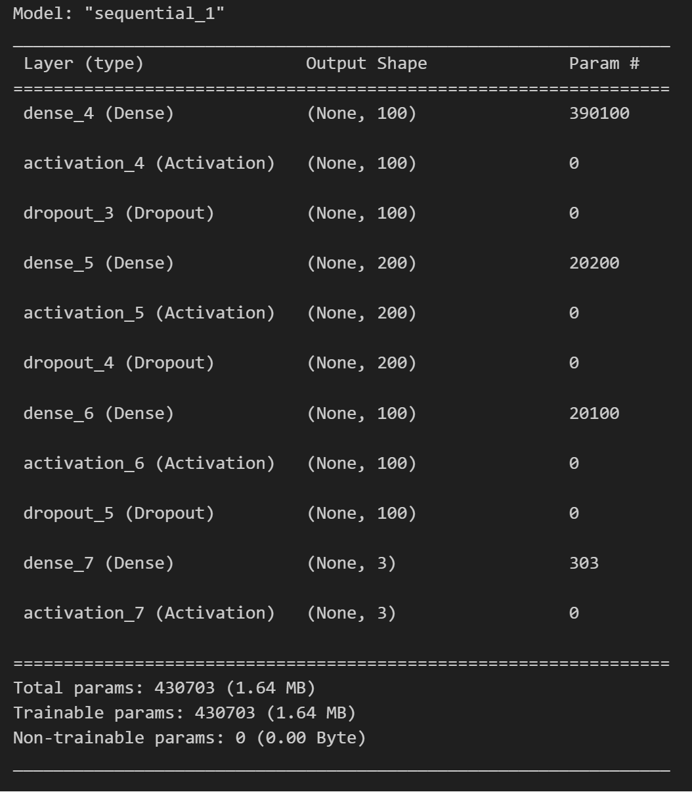
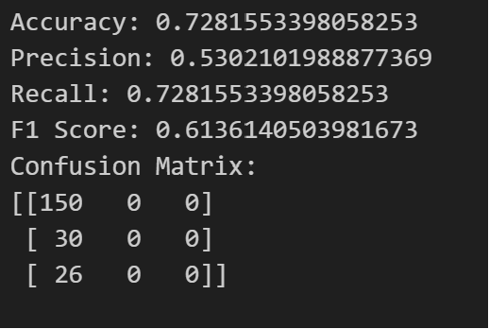
Proposed Models
DenseNet
DenseNet
“ReLU” Activation function to introduce non-linearity
Preventing overfitting
Output shape is 3 as total number of classes is 3

Slide 26
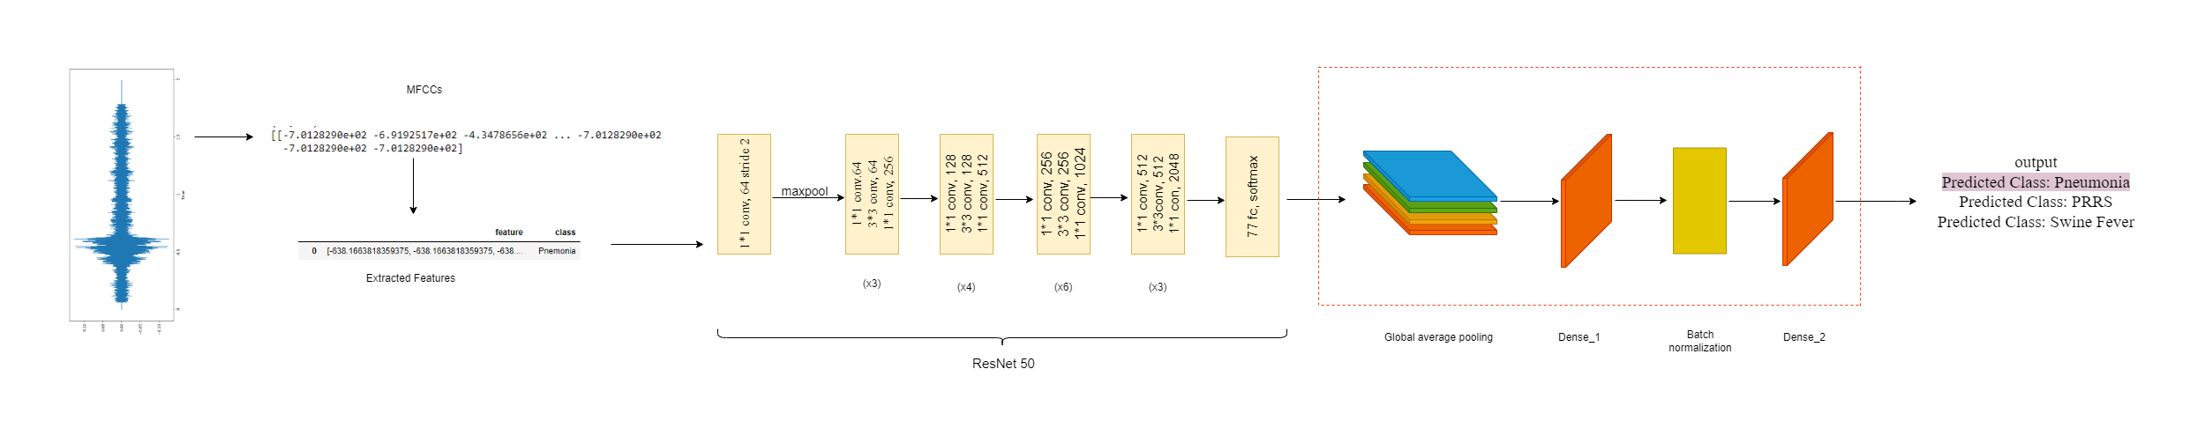
Proposed Models
ResNet
Residual Network (ResNet):
A deep neural network architecture known for effectively handling deep networks.
Its residual blocks help alleviate the vanishing gradient problem.

Slide 27
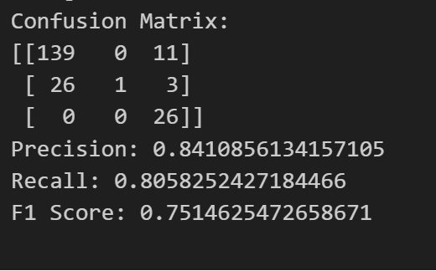
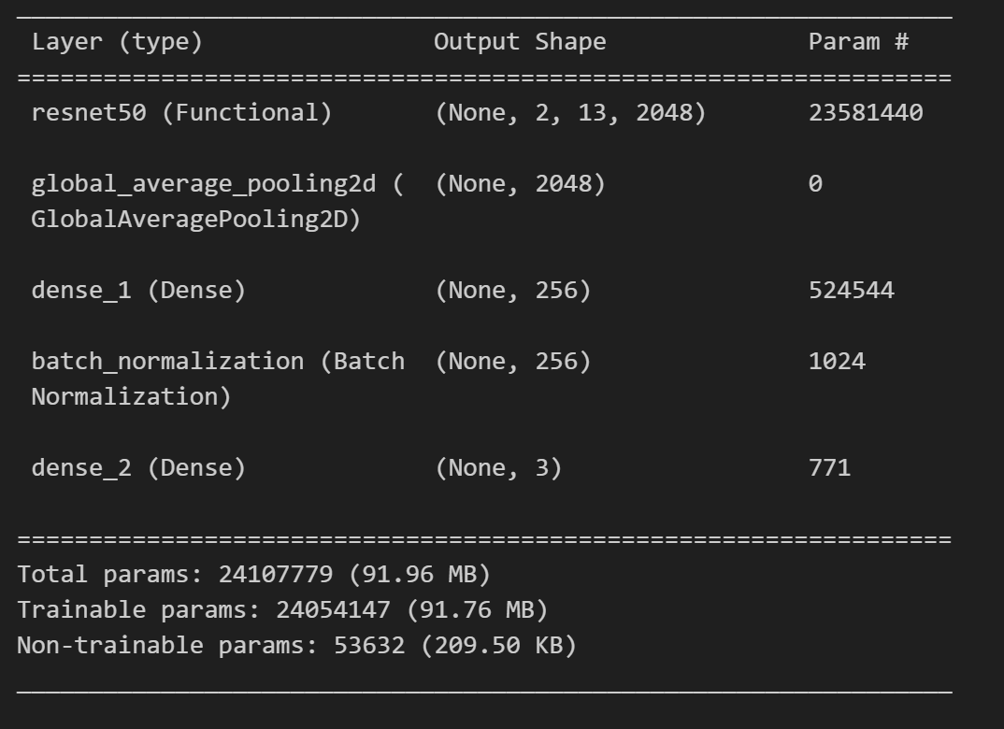
Proposed Models
ResNet
With 23,581,440 parameters, it constitutes the bulk of the model's complexity and capability
Helps in reducing overfitting by minimizing the total number of parameters in the model
Helps in reducing overfitting by minimizing the total number of parameters in the model

Slide 28
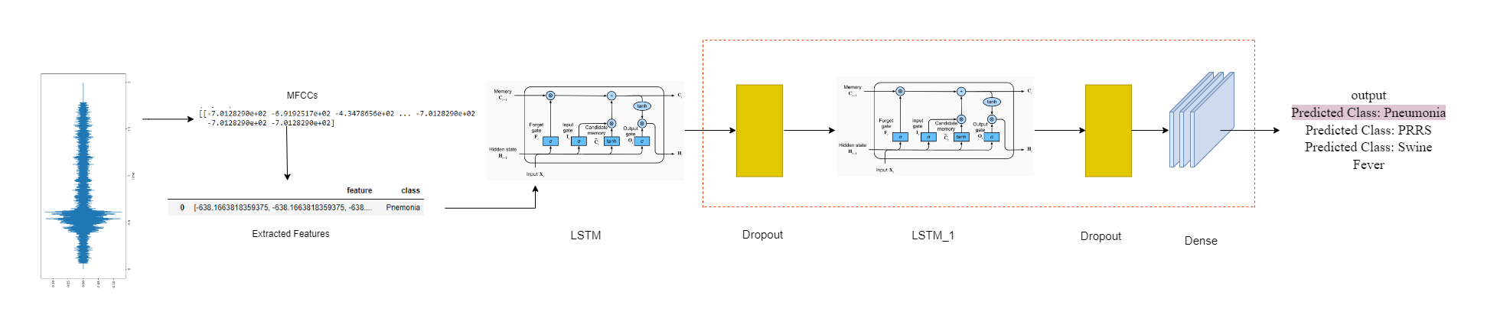
Proposed Models
Recurrent Neural Network
Recurrent Neural Network (RNN):
Specialized in processing sequences for tasks such as speech recognition or language modeling.
Capable of maintaining information in 'memory' over time to capture temporal dependencies.
Effective for analyzing time-series data or sequential data like audio signals, where past information influences the current state.

Slide 29
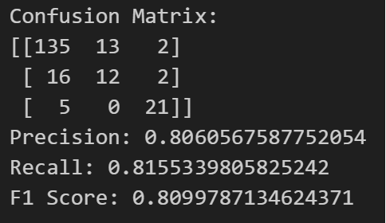
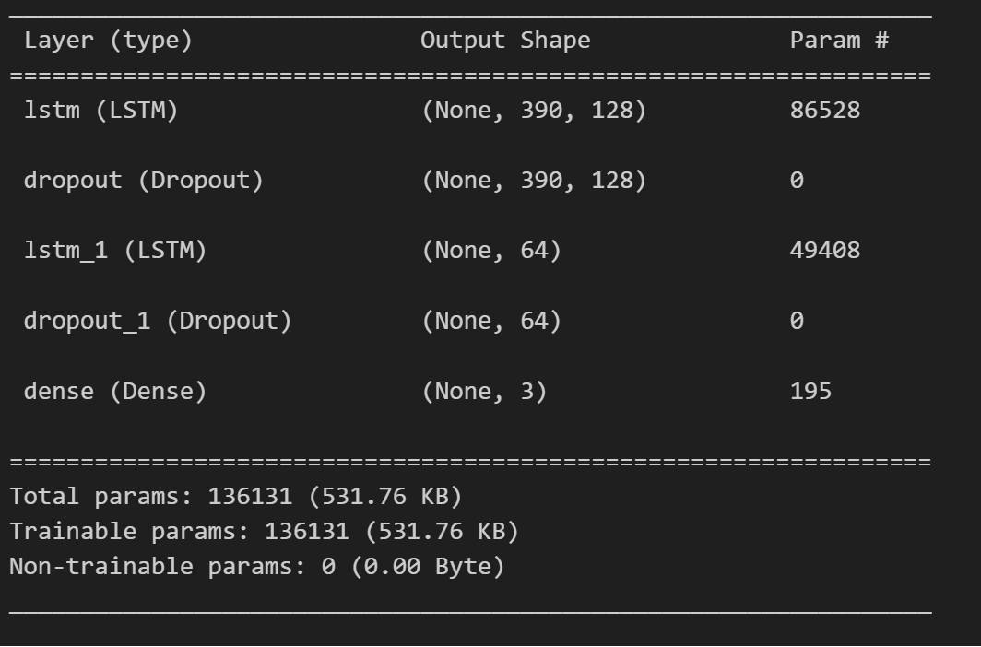
Proposed Models
Recurrent Neural Network
Helps combat overfitting by forcing the model to learn more robust features.
Does not return sequences, preparing the model for the final classification
Helps in reducing overfitting by minimizing the total number of parameters in the model
Notes:
This method helps the model avoid focusing too much on specific details, making it better at understanding different types of data. It also gets the model ready for the final decision without unnecessary information. By using fewer technical details, it prevents the model from becoming too specialized and helps it work well with various kinds of data.

Slide 30
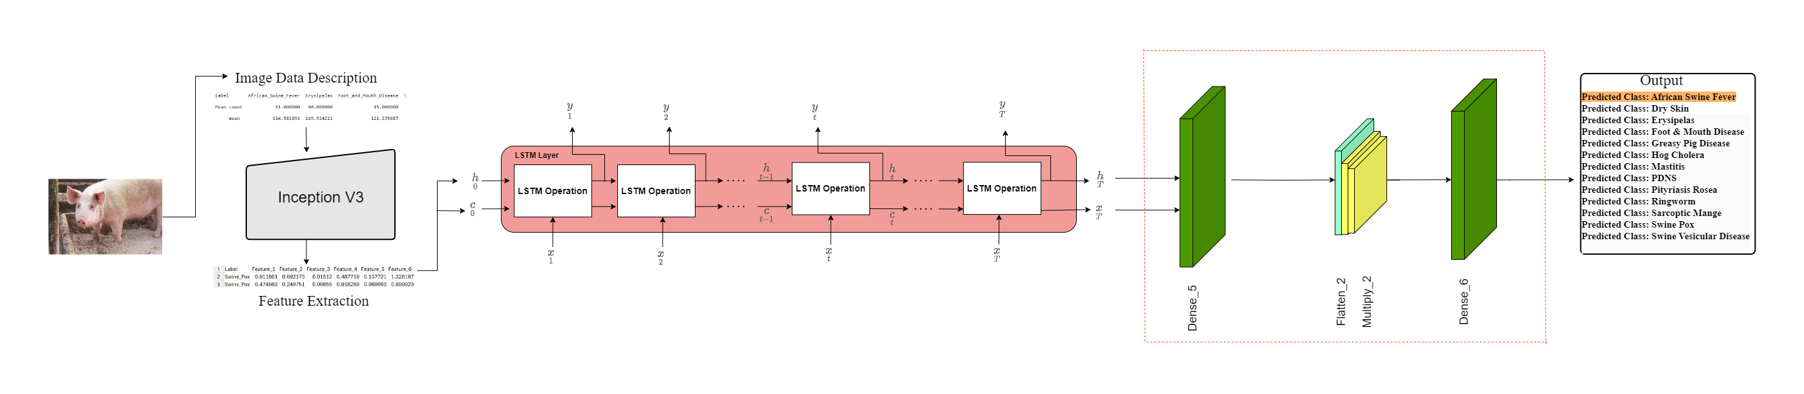
Proposed Models
LSTM
Long Short-Term Memory (LSTM):
Advanced RNN architecture capable of learning long-term dependencies in sequence data.
Ideal for time-series analysis, image classification, natural language processing, and speech recognition tasks.
Effectively handle sequences of image features, capturing temporal dynamics critical for understanding video and image.

Slide 31
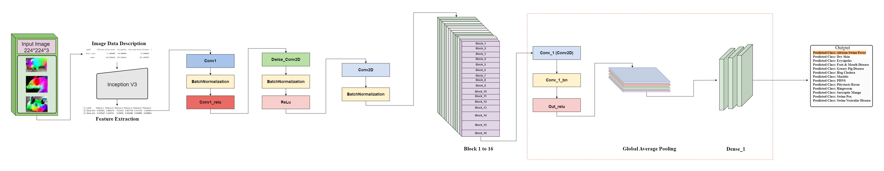
Proposed Models
MobileNet
MobileNet:
A class of efficient models for mobile and embedded vision applications.
Optimized for speed and size while maintaining accuracy, utilizing depth wise separable convolutions.
In this context, MobileNet can effectively process visual data with lower computational resources, making it suitable for real-time applications on mobile devices, such as facial recognition and object detection in images and video streams.
Notes:
MobileNet can achieve this efficiency through the use of depth wise separable conventionals. A method that breakdown standard Convolutions into separate poitwise CNN and fewer parameters

Slide 32
Model Comparison
MODEL | ACCURACY | PRECISION | RECALL | F1 SCORE
SVC | 75.72 | 78.72 | 75.72 | 76.77
Decision Tree | 80.09 | 80.88 | 80.09 | 80.44
Random Forest | 80.49 | 76.57 | 80.49 | 80.22
DenseNet | 74.75 | 53.02 | 72.75 | 61.48
Improved Models
DenseNet | 80.01 | 68.63 | 74.82 | 65.36
RNN | 81.55 | 80.61 | 81.55 | 80.99
ResNet | 80.58 | 84.11 | 80.58 | 75.15

Slide 33
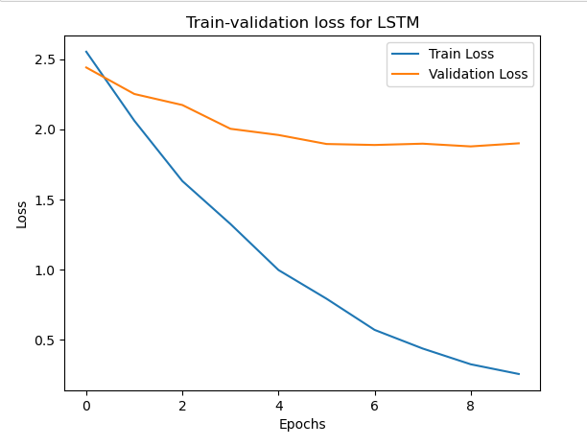
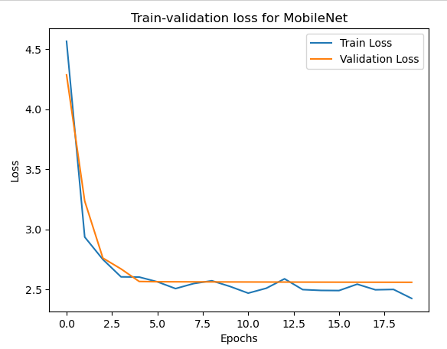
Model Comparison for image data

Slide 34
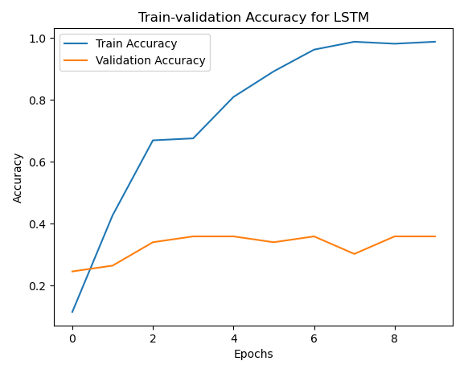
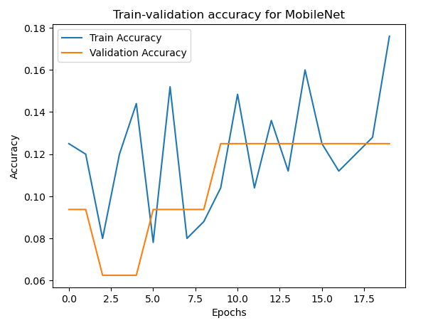
Model Comparison for image data

Slide 35

Web System Design
Web based system implementation
Learn tab
Prediction tab
Visualization tab
System Design

Slide 36
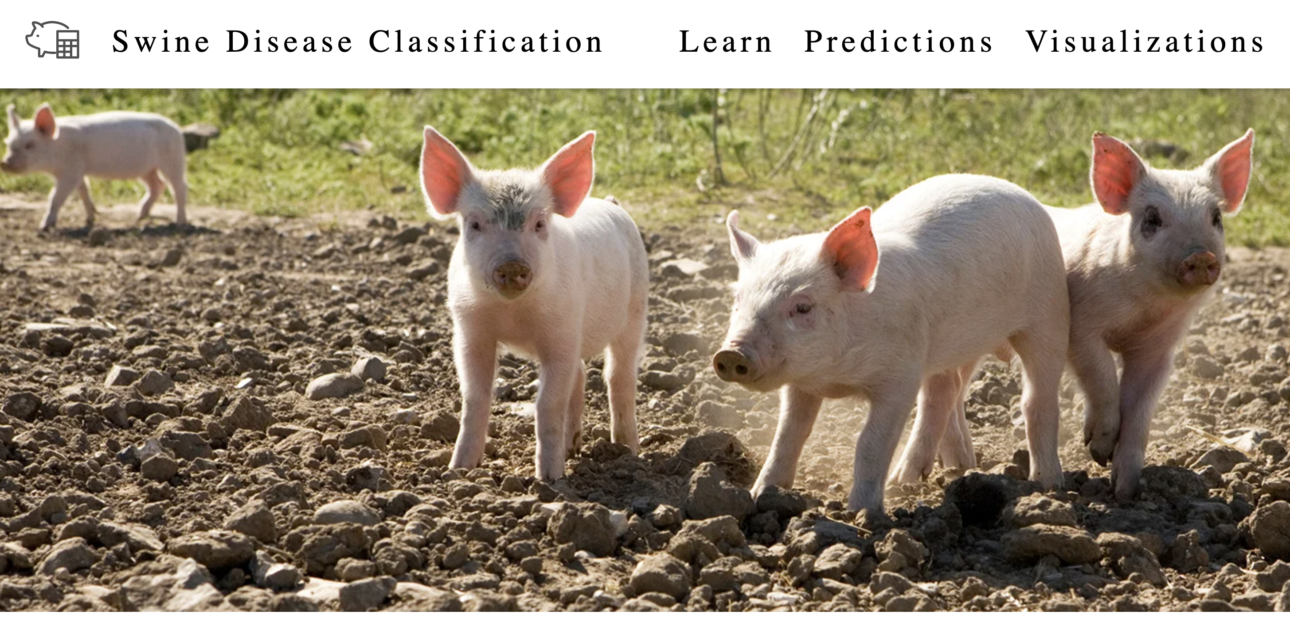
WEB-BASED SYSTEM IMPLEMENTION
Learn tab to discover detailed information about all 15 diseases
Prediction tab enables disease prediction utilizing a Deep Learning model running in the background.
Data visualization
Notes:
Our web-based system was crafted using HTML frameworks, CSS for styling, and JavaScript for data validation, ensuring user input integrity. Leveraging MySQL for database management and PHP for server-side scripting, our system seamlessly integrates front-end and back-end functionalities to deliver a efficient user experience.
as you can see in the picture,
Our website has three tabs on the navigation bar. The "Learn" tab helps users find detailed information about all 13 diseases. In the "Prediction" tab, a smart system predicts diseases using a special model. Lastly, we use data visualization to make information easier to understand

Slide 37
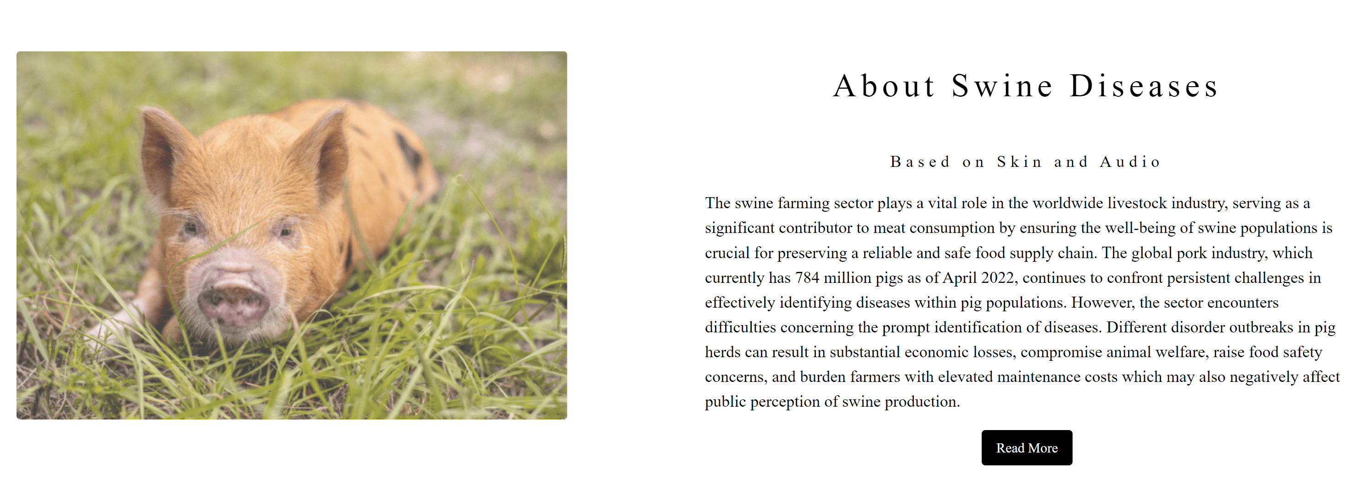
Learn Tab
Contains basic information about all 15 diseases (Reference: Iowa State University)
Enables the farmer to understand the disease better.
Helps the user to choose possible immediate action.
Notes:
Our platform offers comprehensive information on all 15 diseases, sourced from Iowa State University, providing users with essential insights to better understand. This knowledge empowers farmers to make informed decisions regarding disease management and facilitates the selection of appropriate immediate actions to address any potential threats effectively.

Slide 38
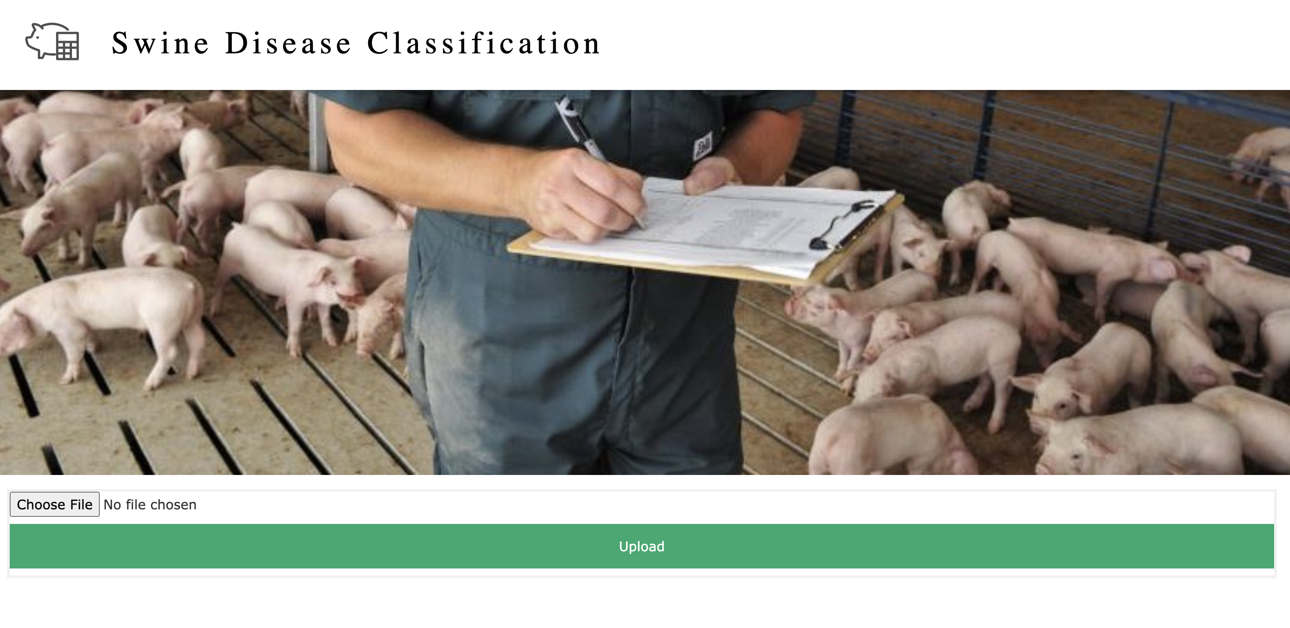
Predictions Tab
Only authorized user can access this page.
Allow the user to upload audio, images and video data.
Classify the disease and displays the statistics.
Notes:
Access to this page is restricted to authorized users only, ensuring privacy and security. Authorized users are granted the ability to upload various types of data, including audio, images, and video files. Upon upload, our system utilizes classification algorithms to identify and classify diseases present in the data. Subsequently, detailed statistics and insights regarding the classified diseases are displayed, aiding users in making informed decisions and taking appropriate actions as necessary.

Slide 39
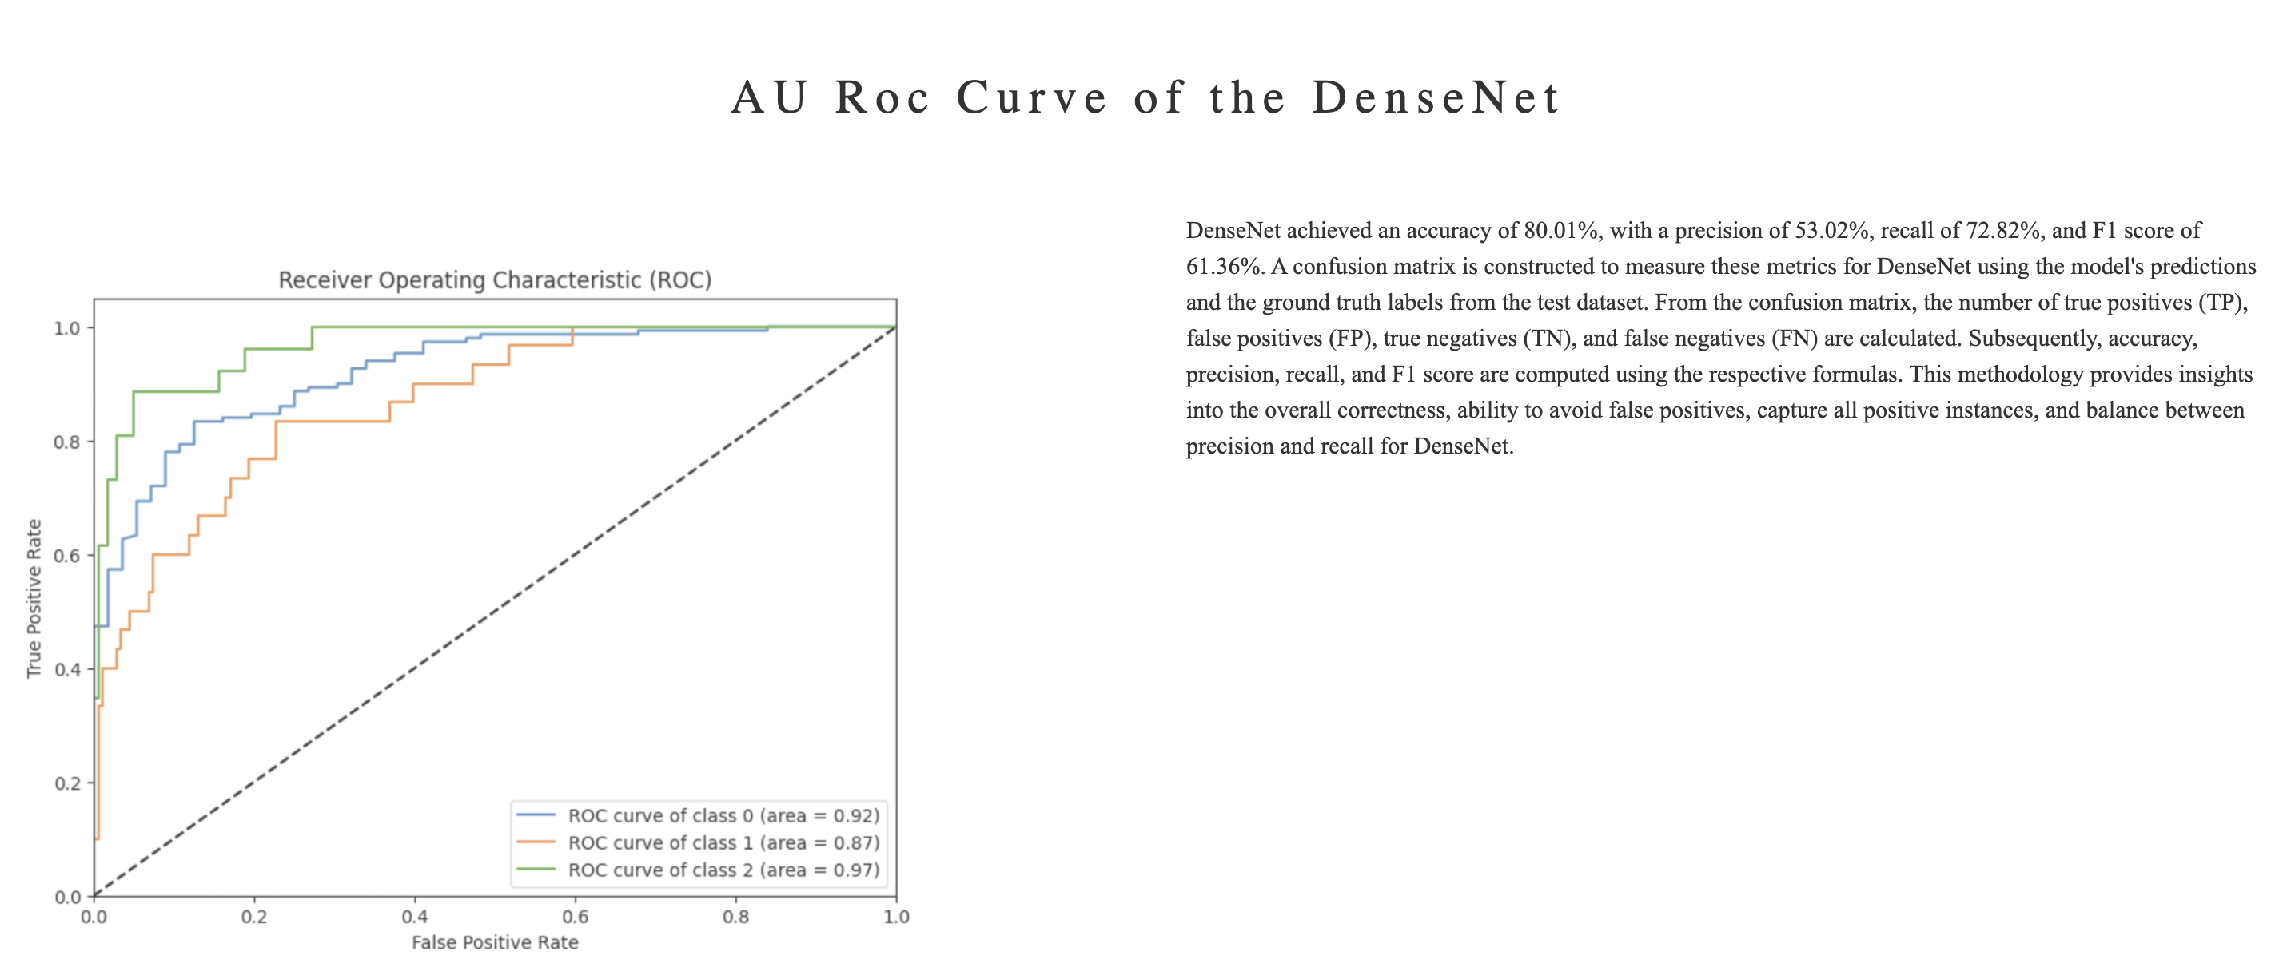
Visualizations Tab
A dashboard of visualizations related to the results.
Visualizes the model performance.
Notes:
The platform features a dashboard comprising visualizations that provide insights into the results obtained. These visualizations offer a comprehensive overview of various aspects, such as disease classifications, trends, and patterns. Additionally, the platform visualizes the performance of the underlying model, offering users a clear understanding of its efficacy and accuracy. By presenting this information in an intuitive and accessible manner, the dashboard facilitates informed decision-making and enables users to assess the reliability of the classification outcomes effectively.

Slide 40
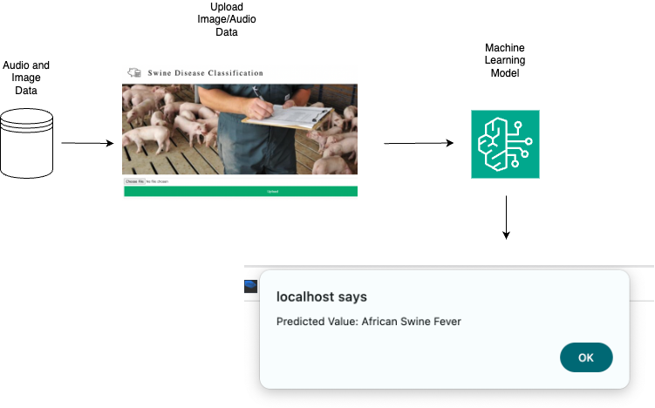
Web Based Implementation
Notes:
In our graphical user interface (GUI), users can easily upload audio and image data, initiating the process by selecting from a range of available machine learning models. These models are specifically designed to analyze the uploaded data and generate predictions. Upon analysis, the model outputs prediction values, with the potential to identify diseases such as African Swine Fever.

Slide 41








System Design Architecture
Request
HTML
Front End
Response
JSON
User
Audio Data Type
Image Data Type
Link Classification
.Py
Prediction Results
Model 1
Model 3
Dense Net
Model 1
GUI Detection
Dense Net
LSTM
Model 2
RNN
Visualizations
Model 2
Model 3
MobileNetV2
Res Net
Pipelines to develop simulations
Error Handling
Virtual graphs of both Image & Audio
Data Integration
Audio Data
Image Data
Model Evaluation
Back End
Database
Notes:
⁠According to our system design, the front end allows users to request responses through the website interface.
•⁠ ⁠Multiple frameworks were utilized in the front end to ensure accurate output.
•⁠ ⁠In the backend, audio and image data were collected and stored in a database.
•⁠ ⁠Subsequently, feature extraction was performed on the integrated data.
•⁠ ⁠For audio files, MFCC was utilized for feature extraction.
•⁠ ⁠For image files, pixel feature extraction was implemented.
•⁠ ⁠This entire process fell under the Data Integration phase.
•⁠ ⁠Following data integration, the integrated data was utilized in the GUI process, where each model was categorized
•⁠ ⁠. Under the audio domain, we employed three types of models: DenseNet, RNN, and ResNet.
•⁠ ⁠For image data, we utilized two different models: LSTM and MobileNetV2.
•⁠ ⁠These implementations were carried out within .py files.
•⁠ ⁠Subsequently, the visualizations were generated separately for both audio and image data.
•⁠ ⁠Pipelines are established to develop specific scenarios within the system.
•⁠ ⁠Graphical representations are employed to enhance clarity and understanding.
•⁠ ⁠The data is divided into various segments to facilitate model building.
•⁠ ⁠After model evaluation, any incorrect data is identified and handled through error handling mechanisms.
•⁠ ⁠Incorrect data is rectified in the backend part of the system Also Displays Whatever the incorrect files.
•⁠ ⁠Accurate predictions are made for correct data.
•⁠ ⁠The front end displays the accurate results to the users

Slide 42
Thank you

